Slide 1









-Hope-
online Furntuier shop
Presented by Logic Trio - Group 5

Slide 2



our team
Lana Batnij
1200308
Amany Hmidan 1200255
Rawan Sous 1200129

Slide 3
Business Description
Our Business: HOPE Furniture Shop
At HOPE Furniture Shop, our mission is to serve our customers through our online platform, available as a website. Our goal is to provide a seamless shopping experience for our diverse clientele, including everyday consumers, companies, supermarkets, clinics and salons.
Our website displays a catalog of our furniture products especially offices of all sizes designs and materials, complete with photos and prices ranging from $30 to $1000, catering to a wide audience. The majority of our visitors are businesses, and big organizers looking for quality furniture.
Our online platform features a robust shopping cart system, allowing customers to add, remove furniture pieces they wish to purchase. The system displays the price for each item and the total balance of the cart. Once satisfied with their selections, customers can proceed to checkout by filling out a form. And they has a choice of delivering or not, The website then prompts the customer to choose from various payment methods.
Our delivery system ensures that the selected furniture products are delivered to the customer's specified location at the chosen time. In addition, customers can choose to get their offices installed at their place.

Slide 4
Scenario Add To crat
Initial assumption Dana wants to buy a new office from hope furniture website , Dana login in as a quest or registered user and filled all info needed to login as name , email ,etc, then Dana has filled the card info and the system confirms that her card is valid (not expired) with decent amount of money to able to add to cart.
• Normal: When a customer logged in or sign up as a guest to add to cart, after login even guest or registered users they both have to fill their card info to be able to add to cart, the customer started shopping by searching for a specific furniture items, the customer browse several furniture items, once he has found the item, he read the details of the furniture item he wants to obtain more information such as (color, material, dimensions, material properties(waterproof.), then he added the item to the cart, once the customer is satisfied with his order and his cart is ready, he decided to buy it, the system checks his balance to add the item to cart successfully , then the system gives the customer the choice to use delivery company and asks the user to fill some info needed such as name , phone number, location and time desired . •
Alternative: Ahmad logged in or signed up , Ahmad has his card validated by the system, and started shopping , he added the piece of furniture he wanted to the cart .his PayPal visa card has only 48$. but the cart ended with an overall value of 50$ by only 4% difference .which exceeds the amount of money in his visa card.so in this case the item is still confirmed and added to cart successfully , and the system gives the user the option to pay the rest in cash. • Alternative: If Rawan filled here info to login to the website since she is a registered user , but system failure has happened leading to error in login authentication , however Rawan still got the choice of visit the website as a guest , fill her card info , and add items desired to card, since to be registered user is only needed for customization .
• Error: If Rawan logged in or signed up to the website with an expired PayPal card, the system will warn Rawan that the PayPal card was invalid or expired. Before she can add any item to the cart. • Error hanin logged in or signed up , and got her card validated but the system server went down before the affirmation message appears to her about her card status , so she could not add any item to card .
• Error Hanin logged in or signed up , and got her card info right , and the system sends these info to the bank to validate it and authorize rawan to use it , how ever an error in the bank system happened , so that the bank did not send the system , the authorization and validation for the card , so hanin could not add any item to card. • Error: Salwa has logged in , or signed up , has her card validated and authorized, Salwa searched for a specific item , saw all details chooses color and size , but when adding to cart , an error happened in the data base that it could not retrieve the price of this specific item , due to Data base server failure.

Slide 5
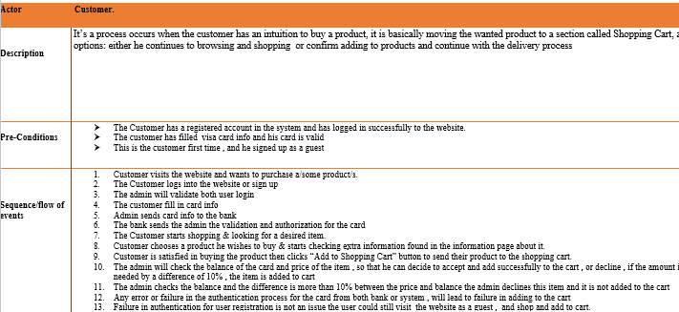
Detailed Description of Scenario

Slide 6
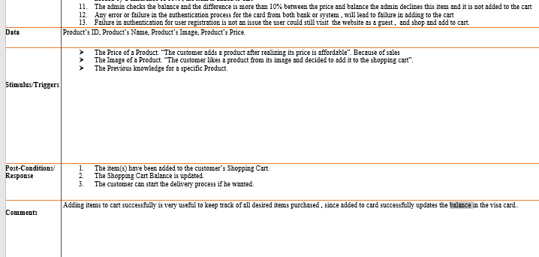

Slide 7
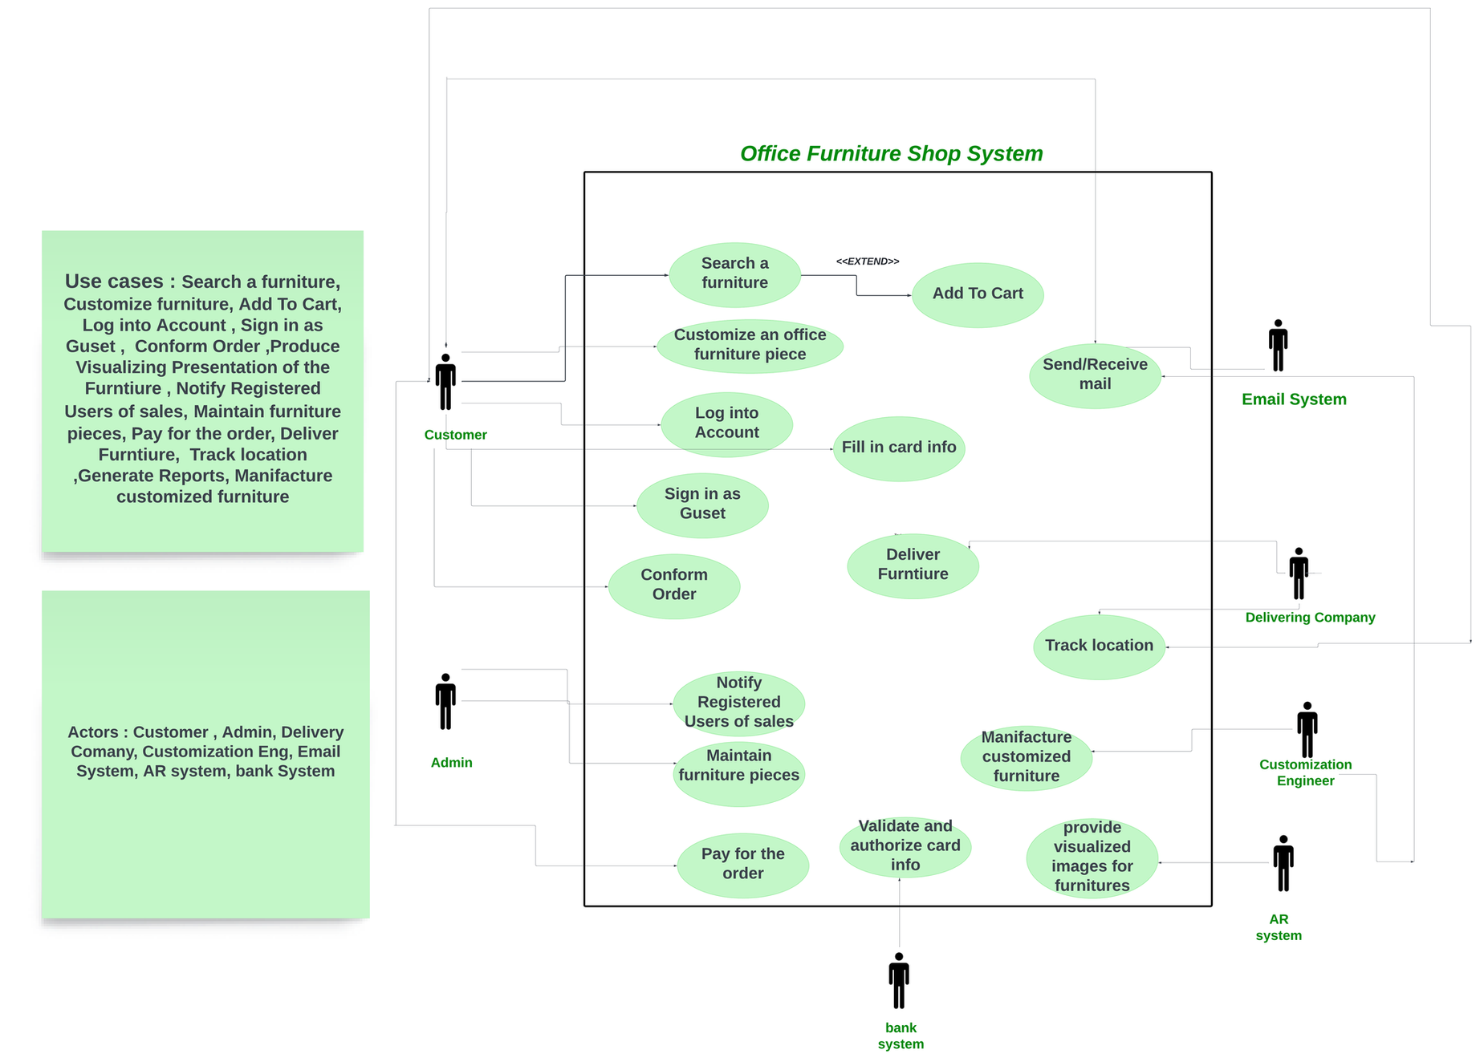
Use Case Diagram

Slide 8
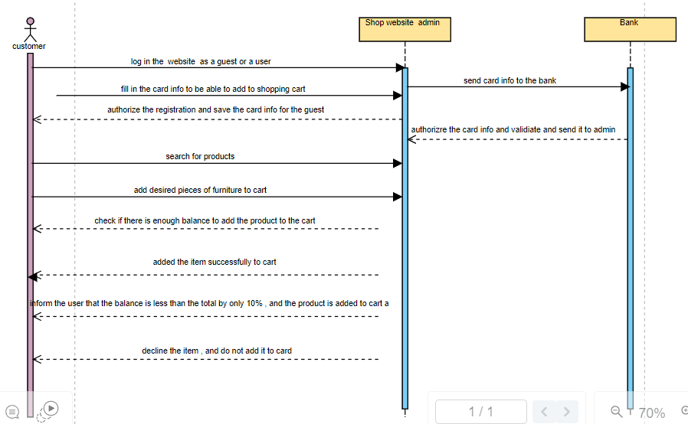
Sequence Diagram fOR ADD To Cart senario

Slide 9
Design Goals
General Goals:
· High Cohesion:
Our system will ensure that related classes and methods are grouped, making each module focused and easy to manage. This organization enhances the clarity and maintainability of the code.
Implementation of components to achieve high cohesion:
oUser Management: this component will include the Customer class and Account class because they are related. It handles customer accounts and their personal information.
Order Management: Manages order processing, including add-to-cart and customized orders. It includes the CustomizatioOrder class and Cart class since they are both related to ordering a furniture piece.
Product Catalog: Manages the products and customization options. It includes Product and CustomizableItem classes.
Payment Processing: Handles payment transactions.
Delivery Management: Manages delivery information and tracking.
oAdmin: for handling all processes that are managed by the website admin.
oCustomization Engineer: for handling information about the engineer that will be assigned to customize the furniture.
· Low Coupling:
Our system will be designed such that modules are largely independent of one another. Changes in one component will have minimal or no impact on others, enhancing the flexibility and ease of updates. Moreover, the components will be separated into three layers based on a three-layer architecture, which typically consists of the presentation layer (UI), the business logic layer (BLL) called the Application layer, and the data access layer (DAL). For example, the UI is responsible for displaying information and capturing inputs and does not need to know which data will be processed and stored. This separation into layers achieves low coupling and makes the system more modular and maintainable.

Slide 10
Specific Goals:
· High performance:
A cache component will be added to store frequently accessed data, this aims to reduce the number of database reads, and hence improve the performance since reading from the cache is much faster, and this way the system can
handle a large number of user requests more efficiently.
·Maintainability
A component called Data Access will be added in order to be responsible for data accessing logic and reading from the cache or database. This way, if we decide to change the data storge technology, only the Data Access component will be changed without effecting the other parts of the system. To implement the data access logic in this component, the Repository pattern can be used, making it easy to switch from a relational database to a cloud storage service like Amazon S3.

Slide 11
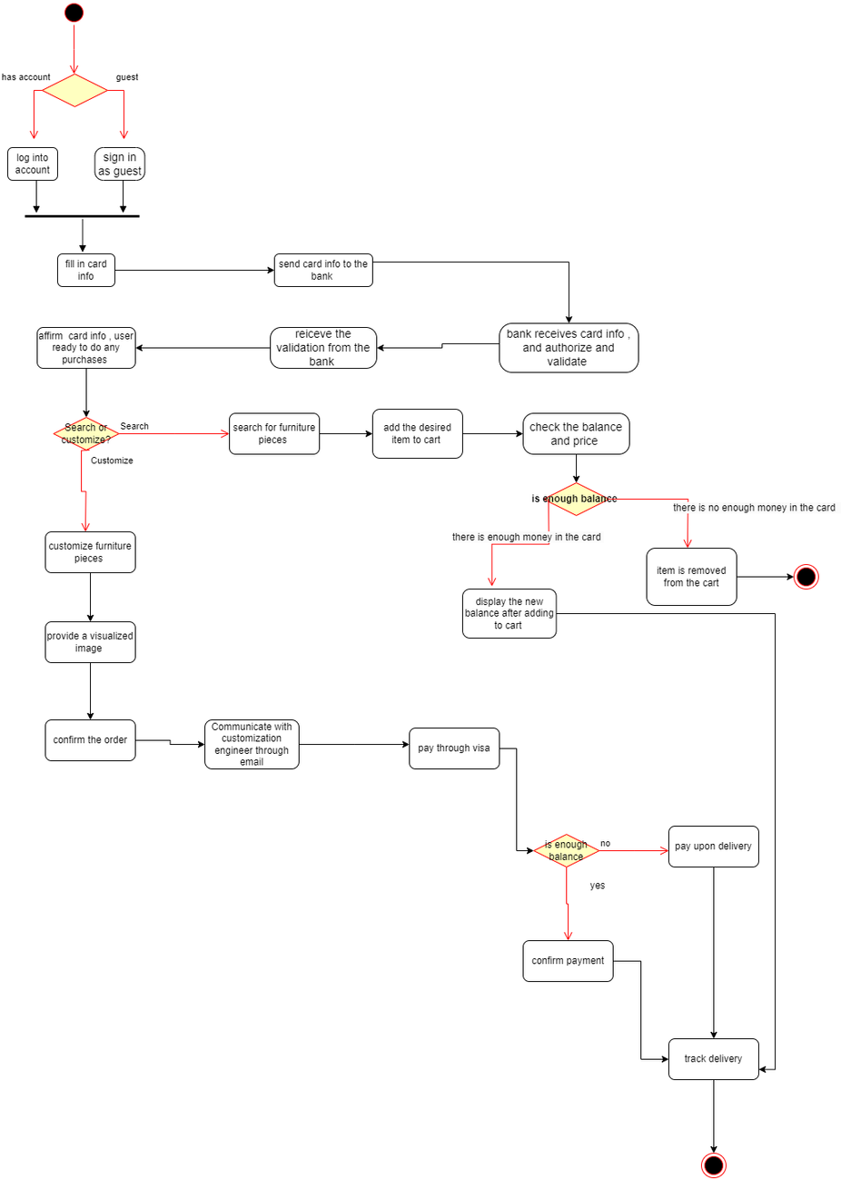
Activity Diagram

Slide 12
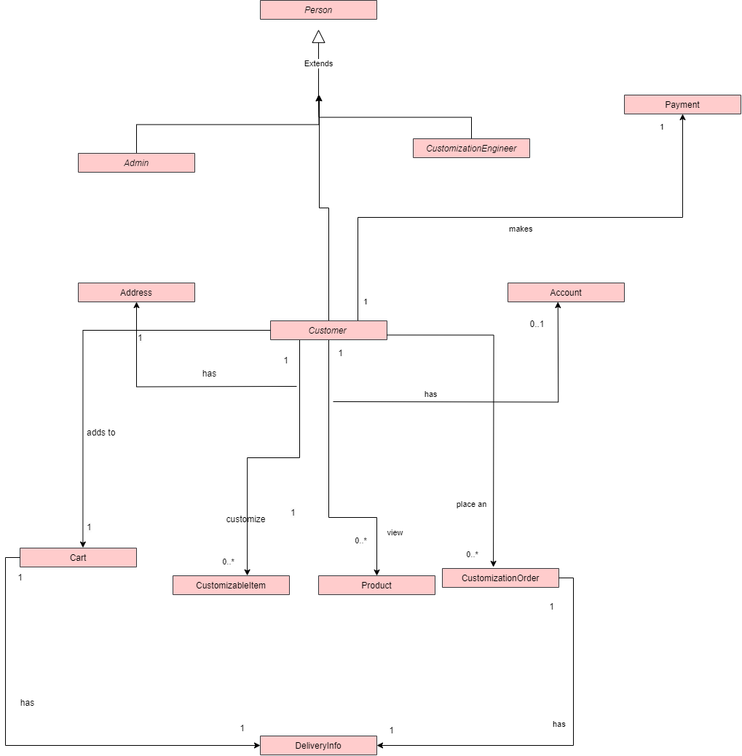
Analysis Class Diagram

Slide 13
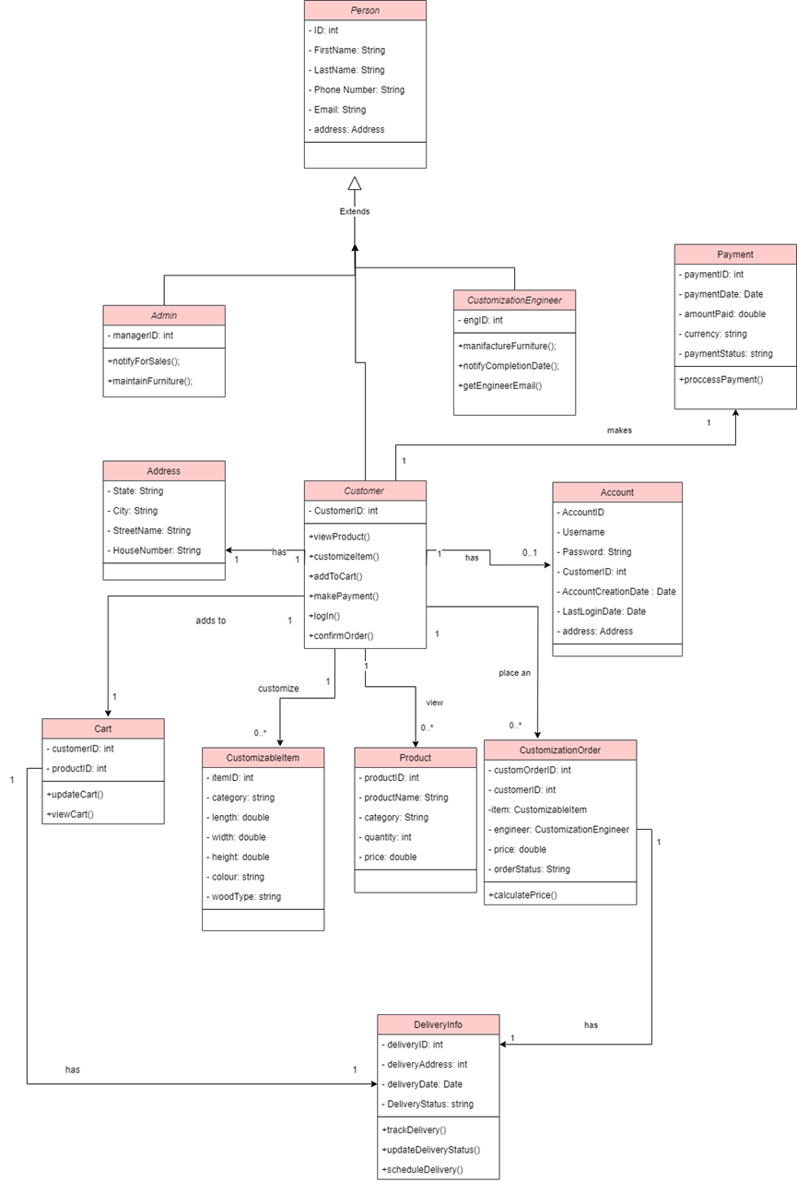
Detailed Class Diagram

Slide 14
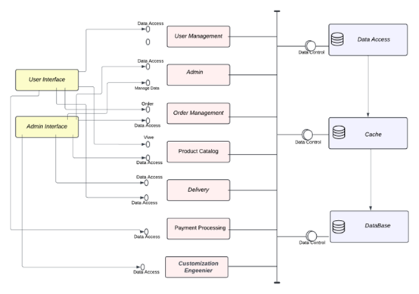
System Component Design:

Slide 15
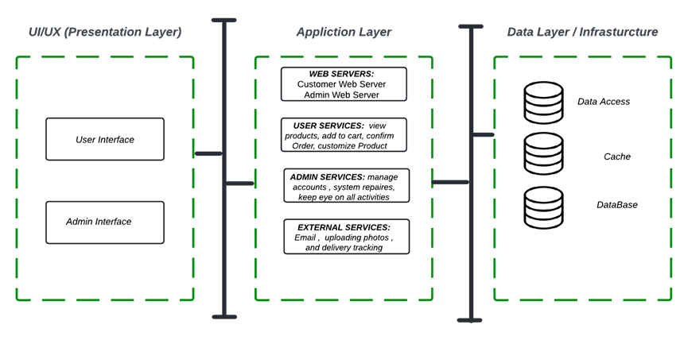
architecture layered Diagram

Slide 16
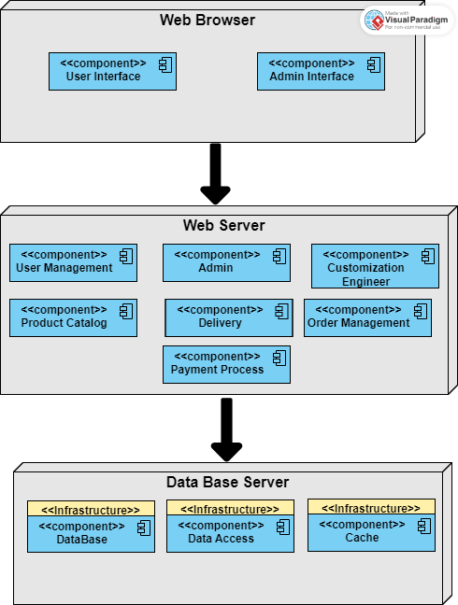
Deployment Diagram

Slide 17
Thank
You

